Slide 1
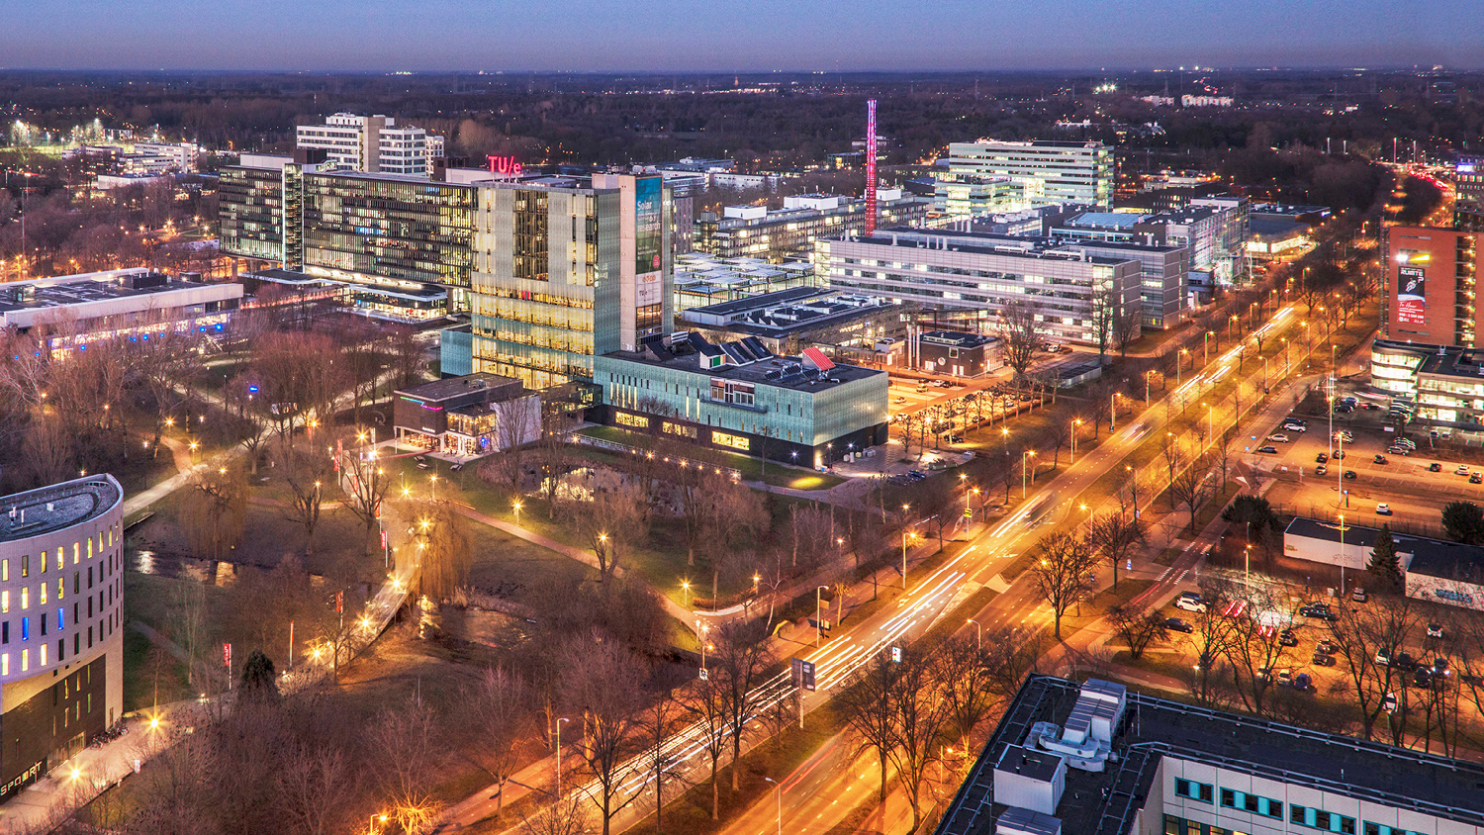
Structure Learning for High-Dimensional Data
SIOUX Presentation, 04-04-2022
Martin de Quincey
Mathematics and Computer Science

Slide 2
Table of content
Problem Setting
Methodologies
Results
Future Directions

Slide 3

Problem Setting
Based on data, learn the structure of a graphical model.
Directed edge $(x, y)$ => $x$ “is useful” in predicting $y$.
Inferred structure must be acyclic.

Slide 4
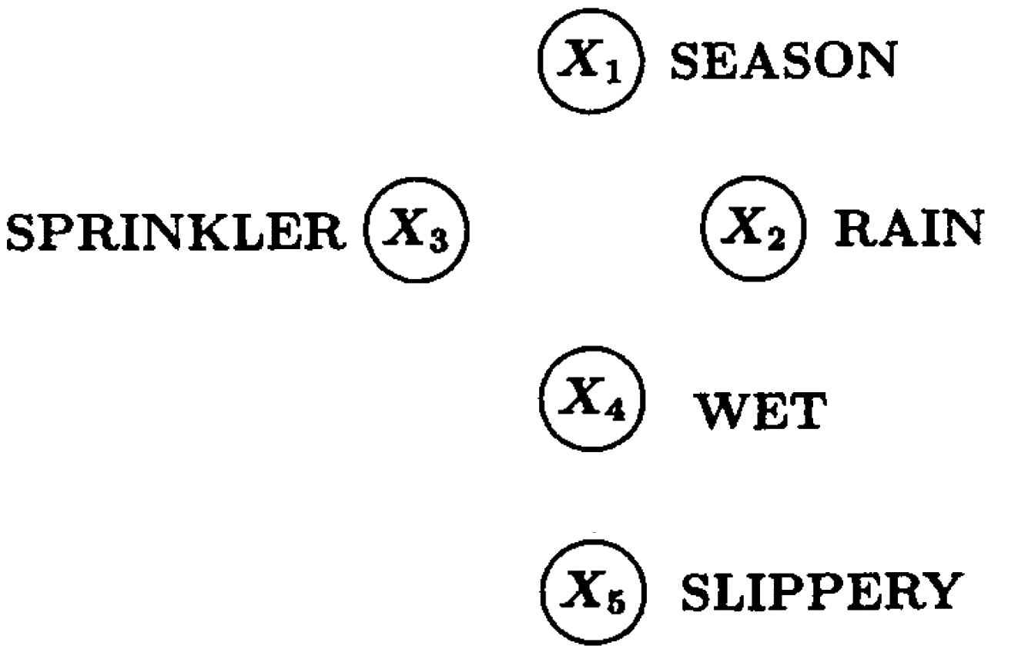



Problem Setting – Example [1]

Slide 5
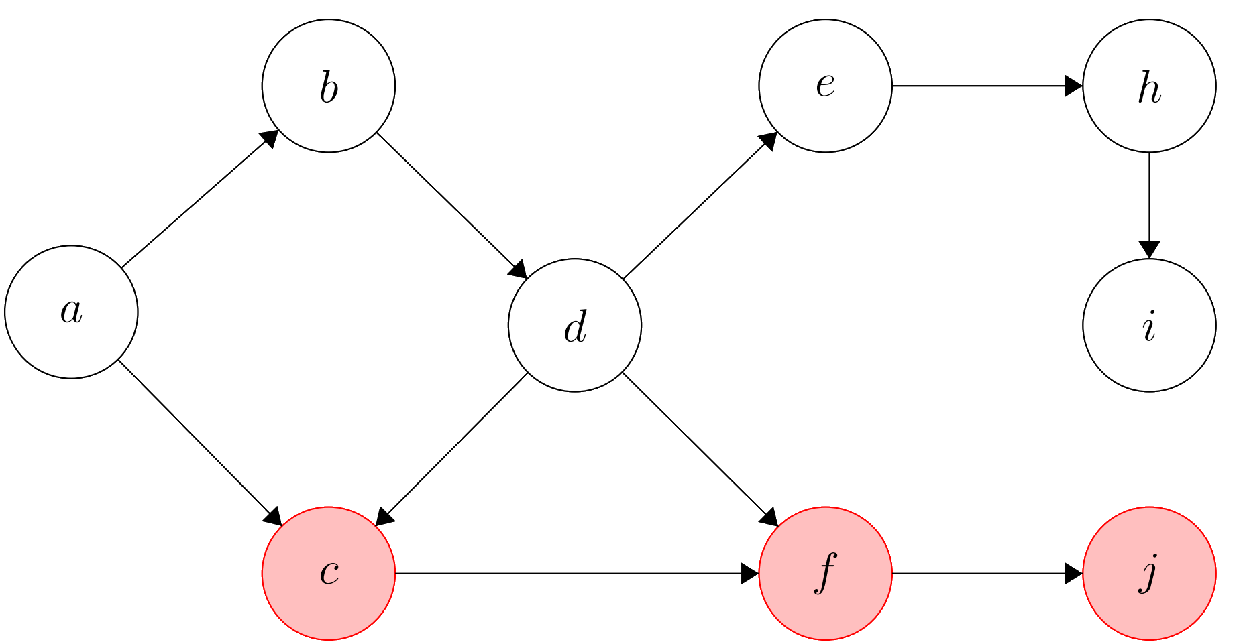
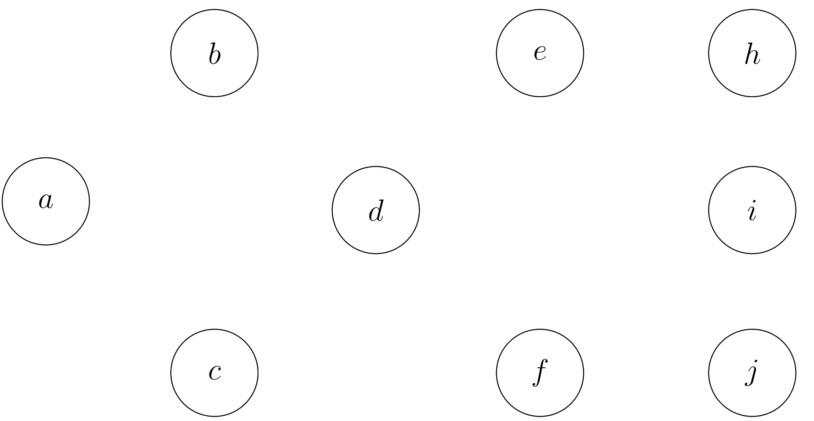
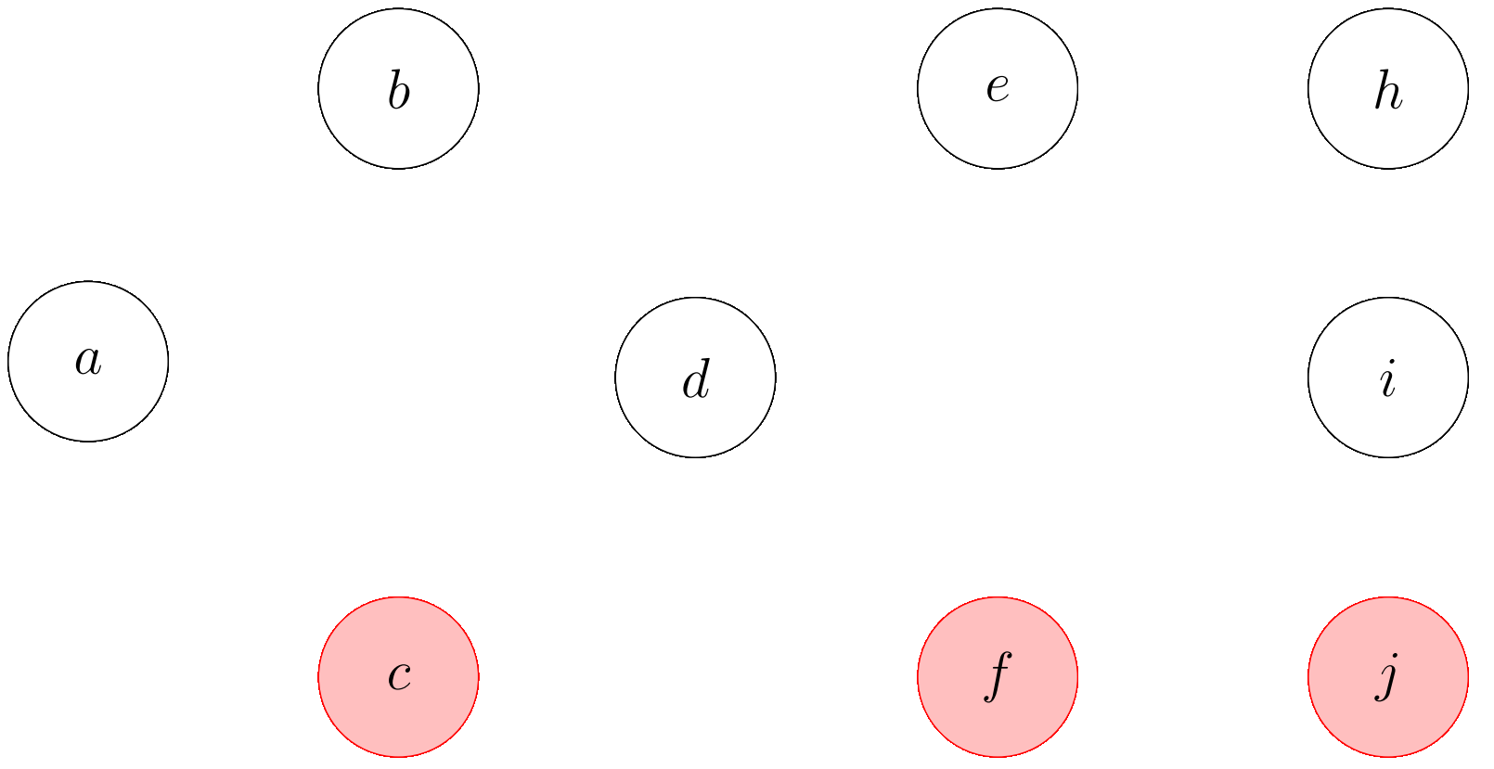
Motivation – Root Cause Analysis in Complex Systems

Slide 6
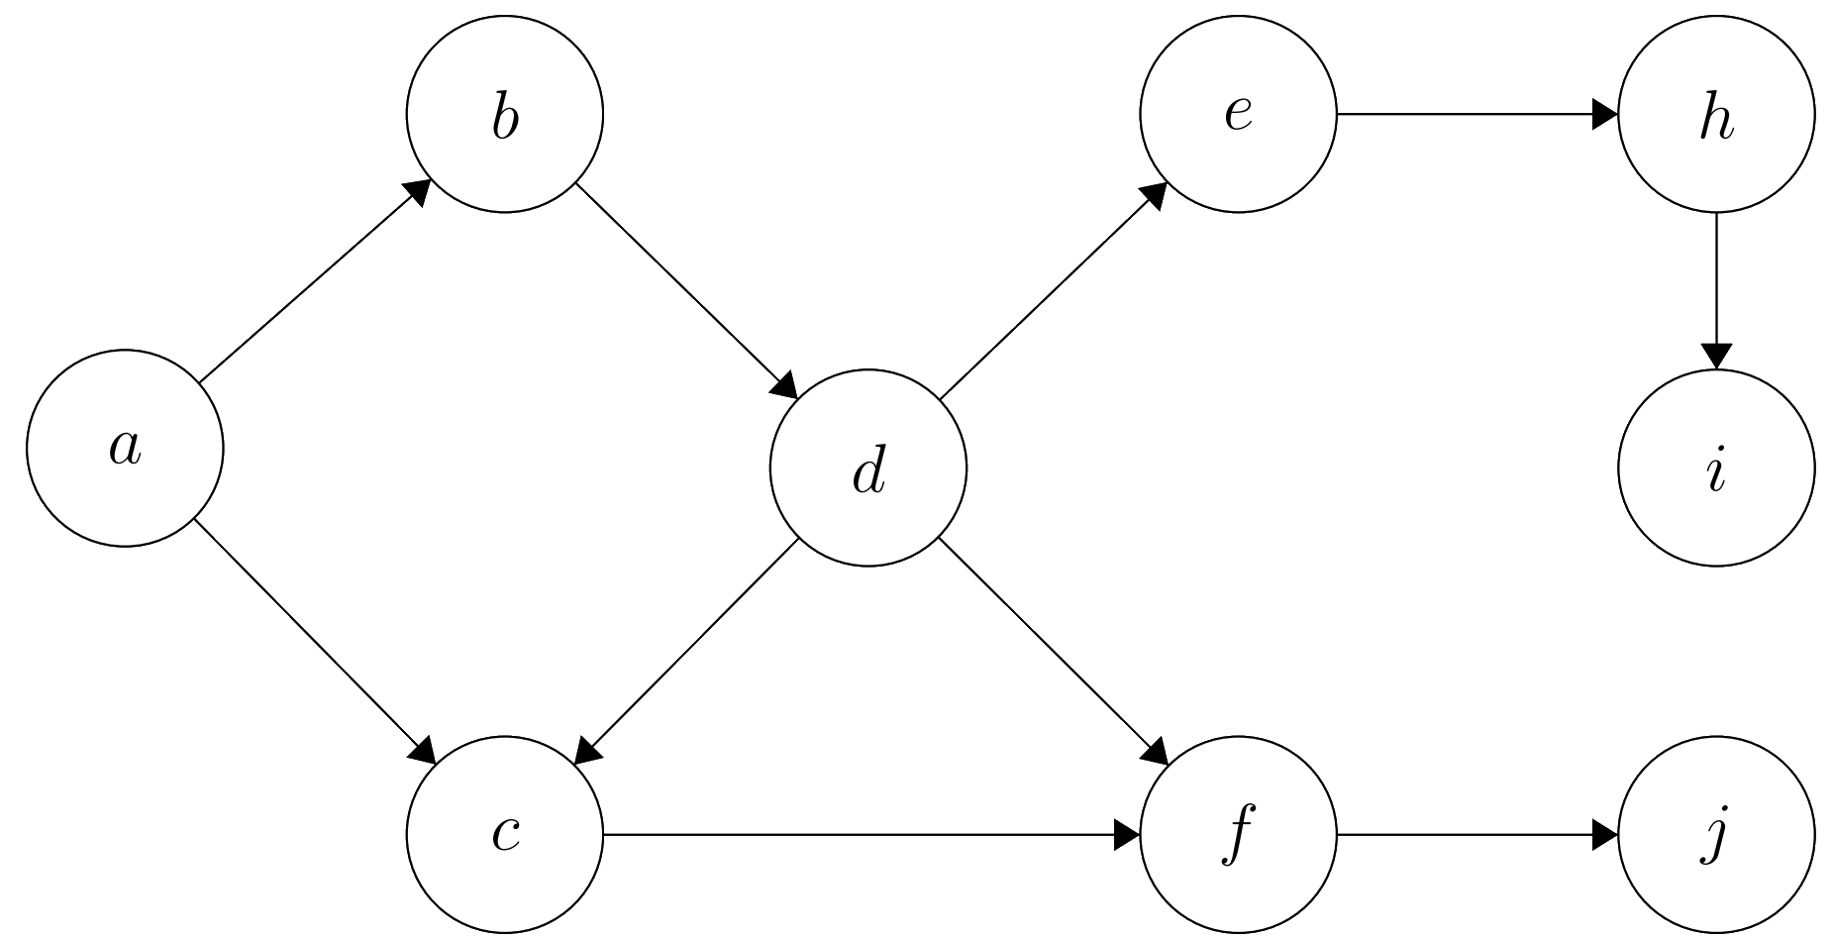
Motivation – Root Cause Analysis in Complex Systems

Slide 7
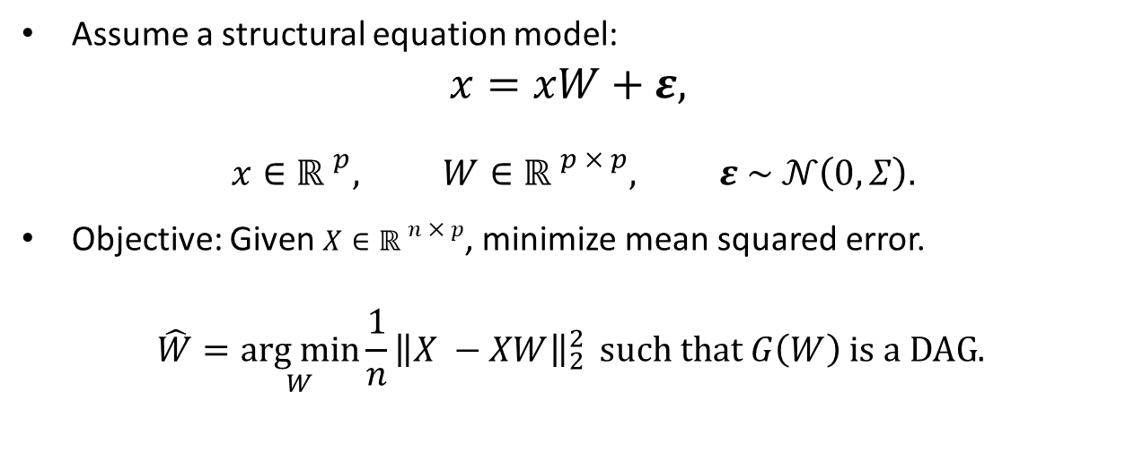
Model
Assume a structural equation model:
$$x=xW+ε,$$
$$x∈{ℝ }^{p}, W∈{ℝ }^{p × p}, ε \sim 𝒩\left(0, Σ\right).$$
Objective: Given $X∈{ℝ }^{n × p}$, minimize mean squared error.
$$\hat{W}=\underset{W}{arg min}{{\frac{1}{n}\left\|X −XW\right\|}_{2}^{2}}{ such that G\left(W\right) is a DAG. }$$

Slide 8
Methodologies
Greedy Random Walk
Orthogonal Matching Pursuit
NO TEARS

Slide 9
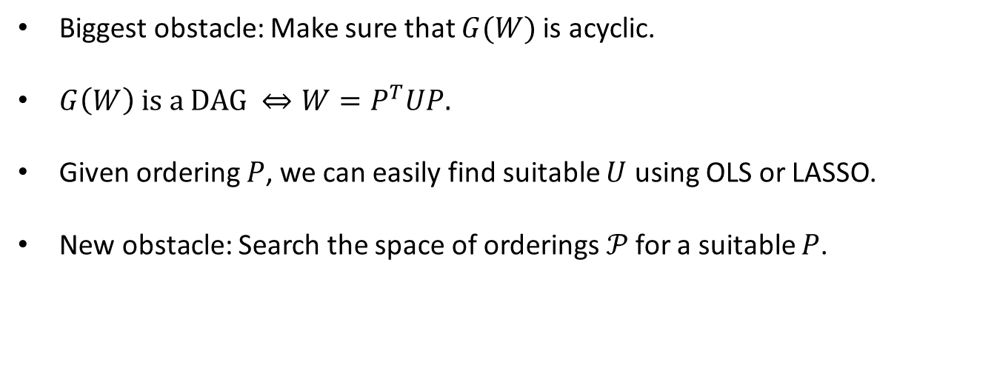
1) Orderings
Biggest obstacle: Make sure that $G(W)$ is acyclic.
$G\left(W\right) \text{is} \text{a} \text{DAG} ⇔{W=P}^{T}UP.$
Given ordering $P$, we can easily find suitable $U$ using OLS or LASSO.
New obstacle: Search the space of orderings$𝒫$ for a suitable $P$.

Slide 10
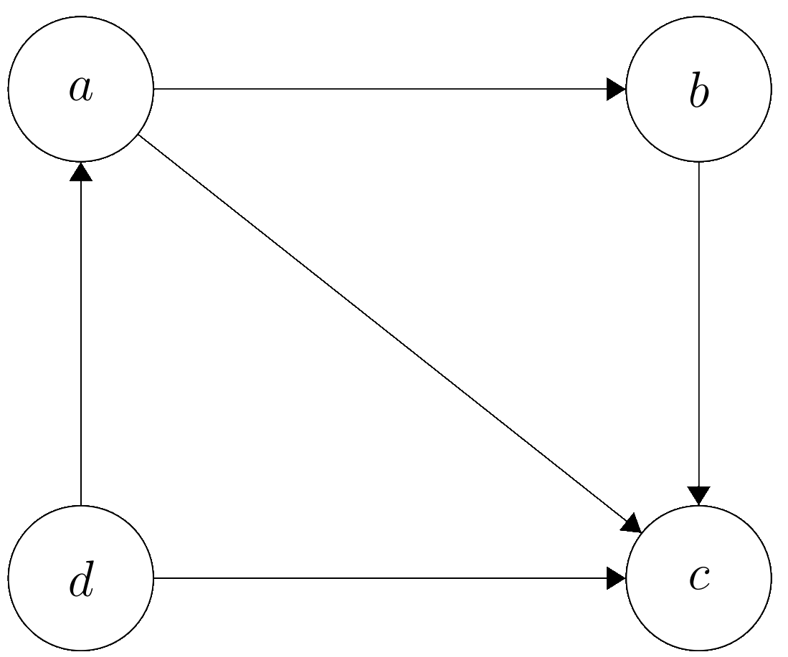
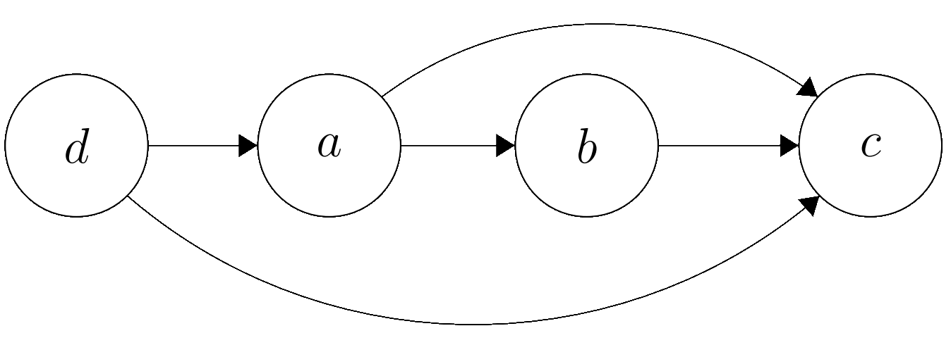

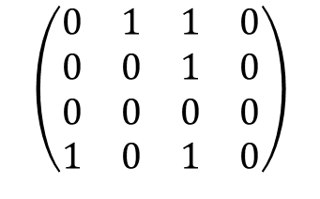

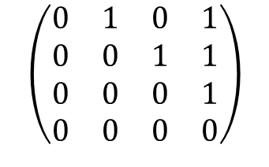


1) Orderings
$$a b c d$$
$$a$$
$$b$$
$$c$$
$$d$$
$$\left(\begin{matrix}0 & 1 & 1 & 0 \\ 0 & 0 & 1 & 0 \\ 0 & 0 & 0 & 0 \\ 1 & 0 & 1 & 0\end{matrix}\right)$$
$$d a b c$$
$$d$$
$$a$$
$$b$$
$$c$$
$$\left(\begin{matrix}0 & 1 & 0 & 1 \\ 0 & 0 & 1 & 1 \\ 0 & 0 & 0 & 1 \\ 0 & 0 & 0 & 0\end{matrix}\right)$$

Slide 11

1) Random Walk
Exhaustively trying all orderings is $𝒪(p!).$
Random Walk on the set of orderings.
Possible transitions: Swapping two variables in the ordering.

Slide 12
1) Greedy Random Walk
Randomly swap the order of two variables.
Transition to this new ordering if it achieves a lower loss.
Iterate until time-out.

Slide 13
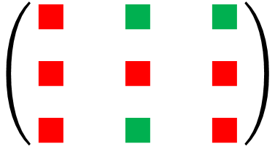
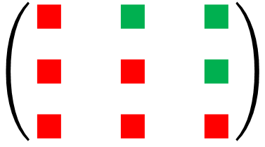

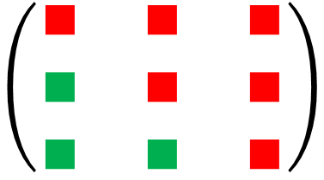
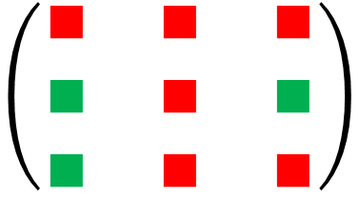
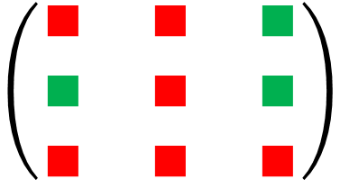

1) Greedy Random Walk
Ordering $(1, 2, 3).$
Try $(1, 3, 2)$
Try $(2, 1, 3)$
Try $(2, 3, 1)$
Try $(3, 2, 1)$
No Improvements Found.
$$\left(\begin{matrix}∎ & ∎ & ∎ \\ ∎ & ∎ & ∎ \\ ∎ & ∎ & ∎\end{matrix}\right)$$
$⟹$no improvement.
$⟹$ improvement.
$⟹$ no improvement.
$⟹$ improvement.
$$\left(\begin{matrix}∎ & ∎ & ∎ \\ ∎ & ∎ & ∎ \\ ∎ & ∎ & ∎\end{matrix}\right)$$
$$\left(\begin{matrix}∎ & ∎ & ∎ \\ ∎ & ∎ & ∎ \\ ∎ & ∎ & ∎\end{matrix}\right)$$
$$\left(\begin{matrix}∎ & ∎ & ∎ \\ ∎ & ∎ & ∎ \\ ∎ & ∎ & ∎\end{matrix}\right)$$
$$\left(\begin{matrix}∎ & ∎ & ∎ \\ ∎ & ∎ & ∎ \\ ∎ & ∎ & ∎\end{matrix}\right)$$

Slide 14
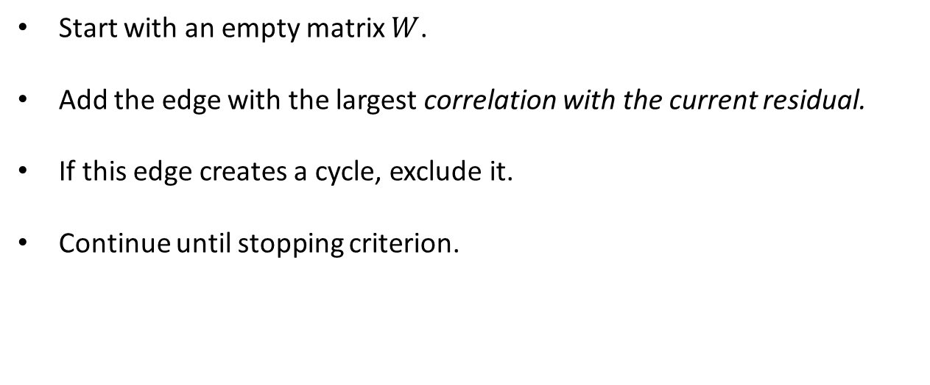
2) Orthogonal Matching Pursuit
Start with an empty matrix $W$.
Add the edge with the largest correlation with the current residual.
If this edge creates a cycle, exclude it.
Continue until stopping criterion.

Slide 15
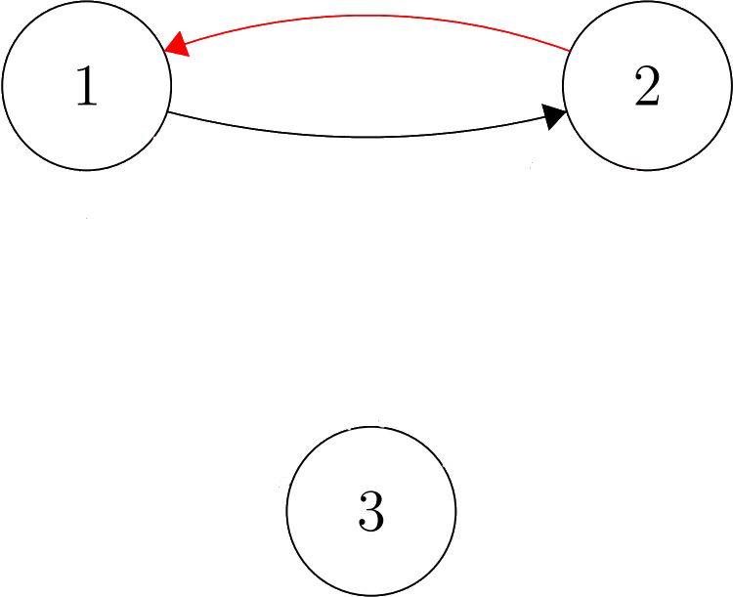
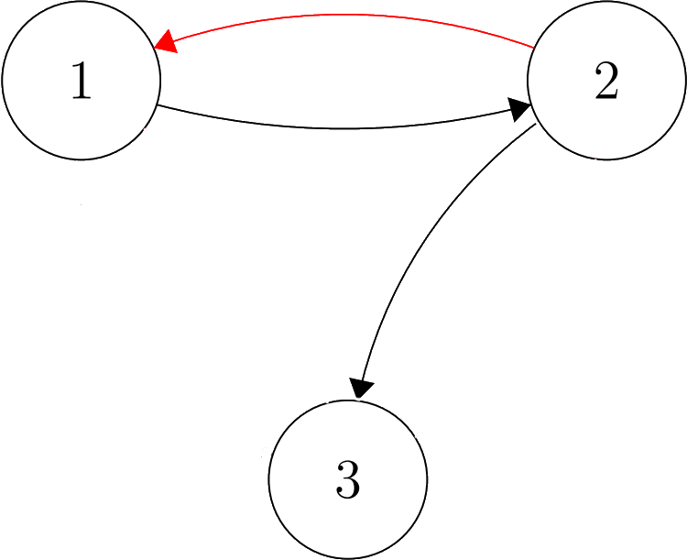
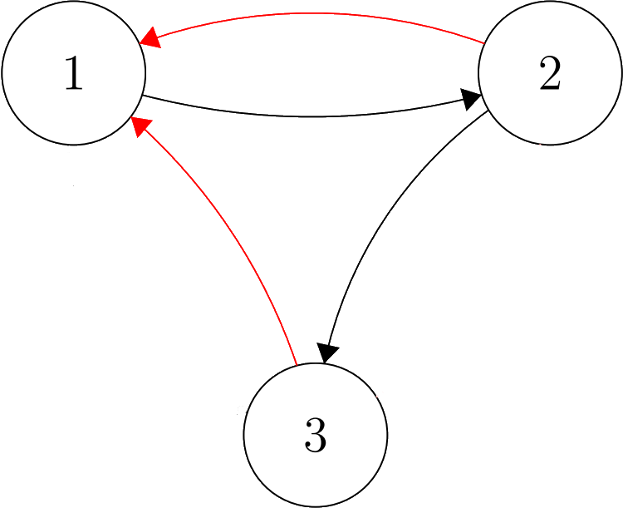
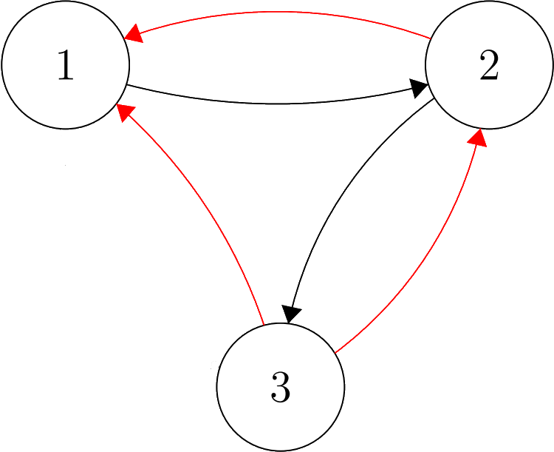
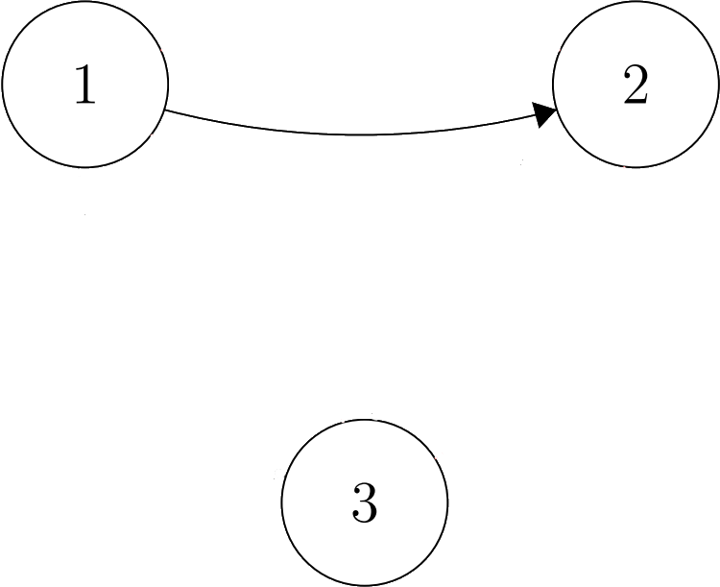

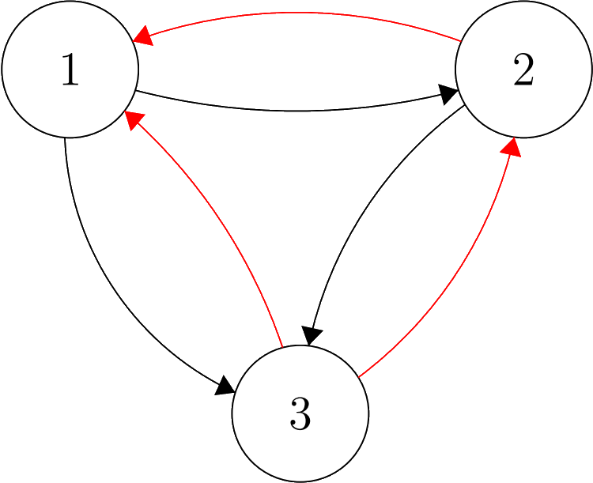
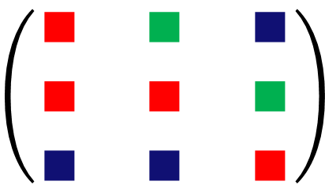
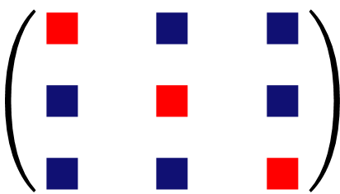
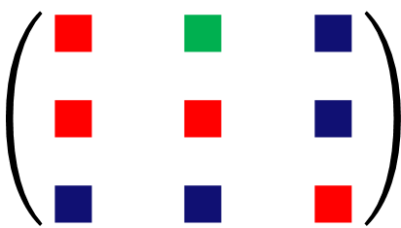
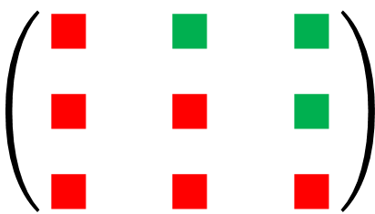
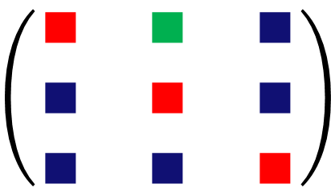
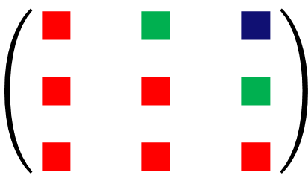
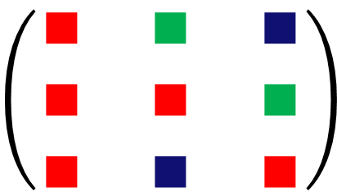
2) Orthogonal Matching Pursuit
$$\left(\begin{matrix}∎ & ∎ & ∎ \\ ∎ & ∎ & ∎ \\ ∎ & ∎ & ∎\end{matrix}\right)$$
$$\left(\begin{matrix}∎ & ∎ & ∎ \\ ∎ & ∎ & ∎ \\ ∎ & ∎ & ∎\end{matrix}\right)$$
$$\left(\begin{matrix}∎ & ∎ & ∎ \\ ∎ & ∎ & ∎ \\ ∎ & ∎ & ∎\end{matrix}\right)$$
$$\left(\begin{matrix}∎ & ∎ & ∎ \\ ∎ & ∎ & ∎ \\ ∎ & ∎ & ∎\end{matrix}\right)$$
$$\left(\begin{matrix}∎ & ∎ & ∎ \\ ∎ & ∎ & ∎ \\ ∎ & ∎ & ∎\end{matrix}\right)$$
$$\left(\begin{matrix}∎ & ∎ & ∎ \\ ∎ & ∎ & ∎ \\ ∎ & ∎ & ∎\end{matrix}\right)$$
$$\left(\begin{matrix}∎ & ∎ & ∎ \\ ∎ & ∎ & ∎ \\ ∎ & ∎ & ∎\end{matrix}\right)$$

Slide 16

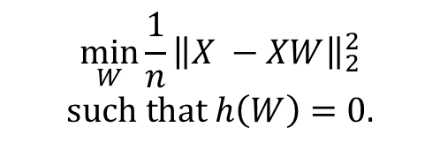
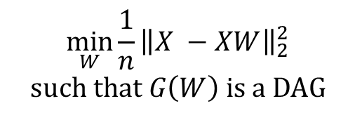
3) NO TEARS
Paper from 2015 by Xun Zheng et al. [2]
Translated the problem from
Where $G(W) \text{is} \text{a} \text{DAG}⟺h(W) = 0$.
$$\min_{W}{{\frac{1}{n}\left\|X −XW\right\|}_{2}^{2}}$$
$$such that G\left(W\right) is a DAG$$
$$\min_{W}{{\frac{1}{n}\left\|X −XW\right\|}_{2}^{2}}$$
$$such that h\left(W\right)=0.$$
to

Slide 17
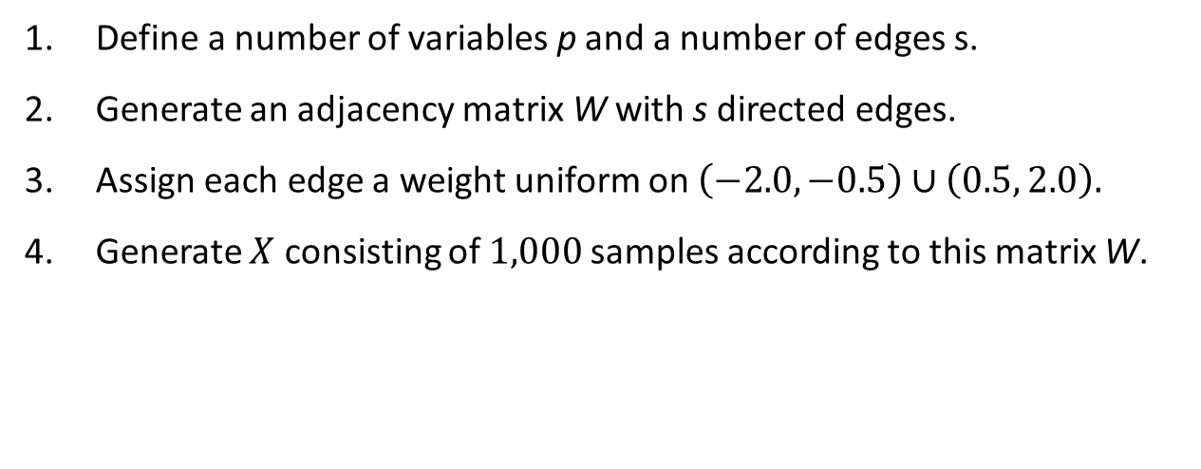
Experimental Results – Generate $X$
Define a number of variables p and a number of edges s.
Generate an adjacency matrix W with s directed edges.
Assign each edge a weight uniform on $\left(−2.0, −0.5\right)∪\left(0.5, 2.0\right).$
Generate $X$ consisting of $1,000$ samples according to this matrix W.

Slide 18
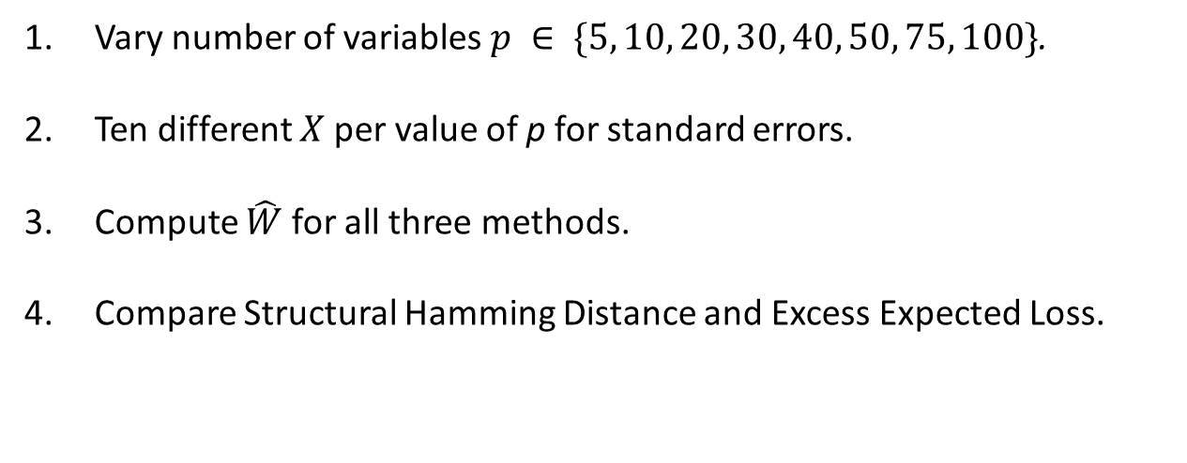
Experimental Results
Vary number of variables $p ∈ \{5, 10, 20, 30, 40, 50, 75, 100\}$.
Ten different $X$ per value of p for standard errors.
Compute $\hat{W}$ for all three methods.
Compare Structural Hamming Distance and Excess Expected Loss.

Slide 19
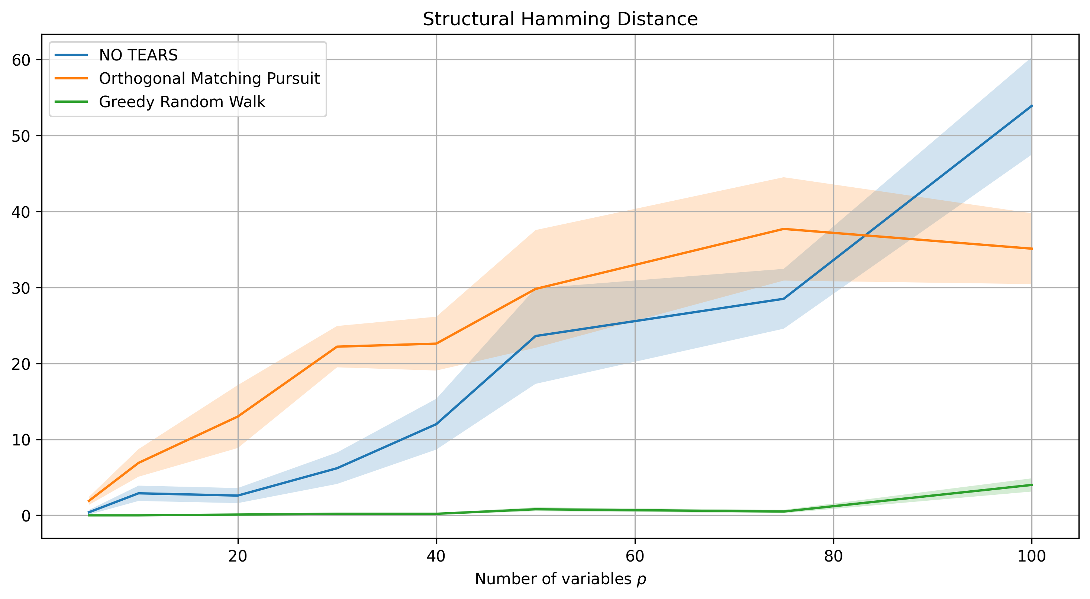
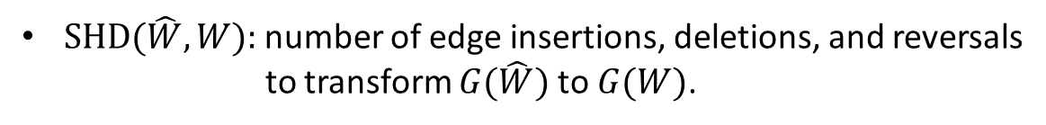
Structural Hamming Distance
$\text{SHD}(\hat{W}, W):$number of edge insertions, deletions, and reversals to transform $G(\hat{W})$ to $G(W)$.

Slide 20
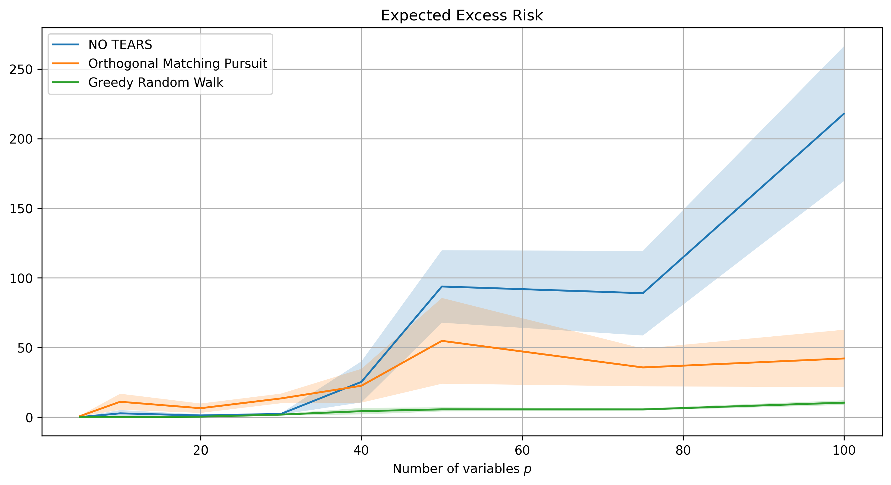
Expected Excess Loss - $𝔼\left[{\left\|x −x\hat{W}\right\|}_{2}^{2}{− \left\|x −xW\right\|}_{2}^{2}\right]$

Slide 21
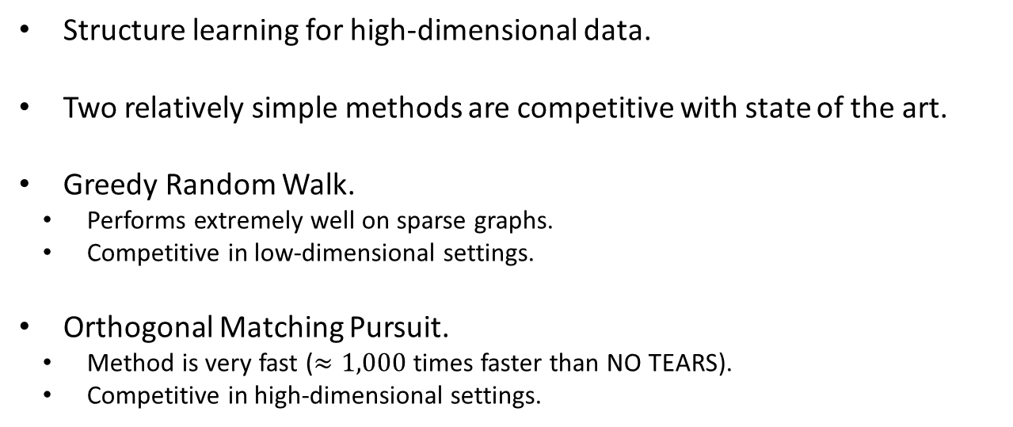
Conclusions
Structure learning for high-dimensional data.
Two relatively simple methods are competitive with state of the art.
Greedy Random Walk.
Performs extremely well on sparse graphs.
Competitive in low-dimensional settings.
Orthogonal Matching Pursuit.
Method is very fast ($≈1,000$ times faster than NO TEARS).
Competitive in high-dimensional settings.

Slide 22
Coming Months
Extend the methodologies to time series data.
Investigate regularization.
Statistical guarantees.

Slide 23
References
wwwwwwwwwwww
[1] Pearl, J. (1997). Causality: Models, Reasoning, and Inference, Second Edition, p.15 .
[2] Zheng, X., Aragam, B., Ravikumar, P., Xing, E. (2018) DAGs with NO TEARS: Continuous Optimization for Structure Learning. Proceedings of the 32nd International Conference on Neural Information Processing Systems. p.9492-9503.

